Slide 1
Seng 275 software testing dr. navneet kaur popli

Slide 2
Automation testing

Slide 3

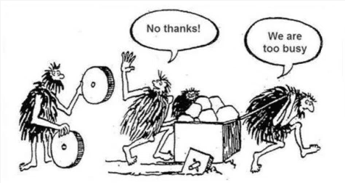
Manual vs automated testing

Slide 4
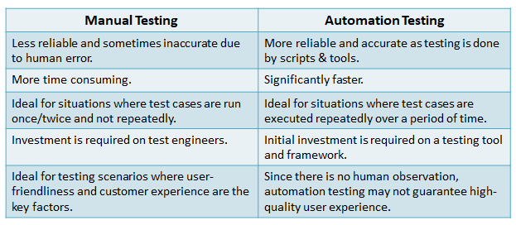

Slide 5
An automated testing tool
An automated testing tool can
playback pre-recorded and predefined actions,
compare the results to the expected behavior and
report the success or failure of these manual tests to a test engineer.
Once automated tests are created, they can easily be repeated, and they can be extended to perform tasks impossible with manual testing.

Slide 6
Escaped Defects Found
An escaped defects is a defect that was not found by, or one that escaped from, the quality assurance team.
Typically, those issues are found by end users after released version has made available to them.
The metrics Escaped Defects Found counts number of new escaped defects found over period (day, week, month).

Slide 7
Advantages of automation testing
No human intervention required
Saves cost.
Fast, accurate, efficient, reliable, consistent
Humans have to sleep-machines don’t.
It is difficult to test for multilingual sites manually
Scales well.
Does repetitive tasks well. Manual Testing can become boring and hence error-prone.
Early defect detection.
Less ‘Escape Defect Found’
Easy to prepare environment for DevOps for CICD pipelines.
Wider test coverage of application features
Re-usable test scripts
Early time to market

Slide 8
Advantages of automation testing
Automated testing can do what work very effectively and is quickly replacing 50-100 testers.
Testing has matured. You are no longer only focussing on functionality but giving most of your attention to user requirements.
Successful testing also involves evaluating user requirements.
Test Frequently and thoroughly: Automation testing runs on every build including doing regression testing. Number of builds are a lot so testing every build on time is easier with automation.
Backward compatibility can be tested as well in addition to all different types of tests.

Slide 9
Advantages of automation testing
Also using automation we are writing a program and it stays with the organization. This is opposed to a tester who leaves the organization and takes his skill and experience with him.
Normally you would start the test at 12:00 pm at night and it will give you the result at 8:00 am in the morning.
You add a new feature, within 2 hours you would get the test results for that feature. So there is early problem detection. More lag time makes the fix more costly.
Also say it has to install some drivers for testing environment which is a very tedious manual activity. It takes 10 people 20 man hours. In automation, those man hours are saved.

Slide 10
Using VMs for automation testing
Using VMs you can do different tests parallelly.
You can scale well.
You can install different platforms in different VMs for different types of testing.

Slide 11



Manual testing is still important
Where you have to sit with the customer and make sure all his requirements are properly captured.
You have to prepare scenarios for the customers, validate flows etc.
The user perspective and look and feel is important.

Slide 12
Selenium ide

Slide 13
Selenium extension for chrome
Download selenium ide extension for chrome/firefox.
Record a new test case in a new project
DemoSelProject
Give url for only testing blog website
http://only-testing-blog.blogspot.com/2014/01/textbox.html

Slide 14
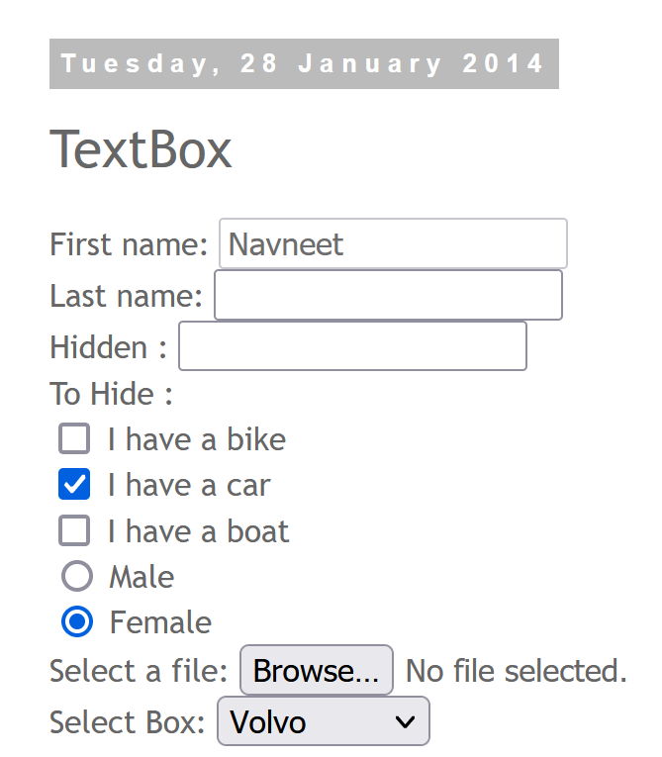
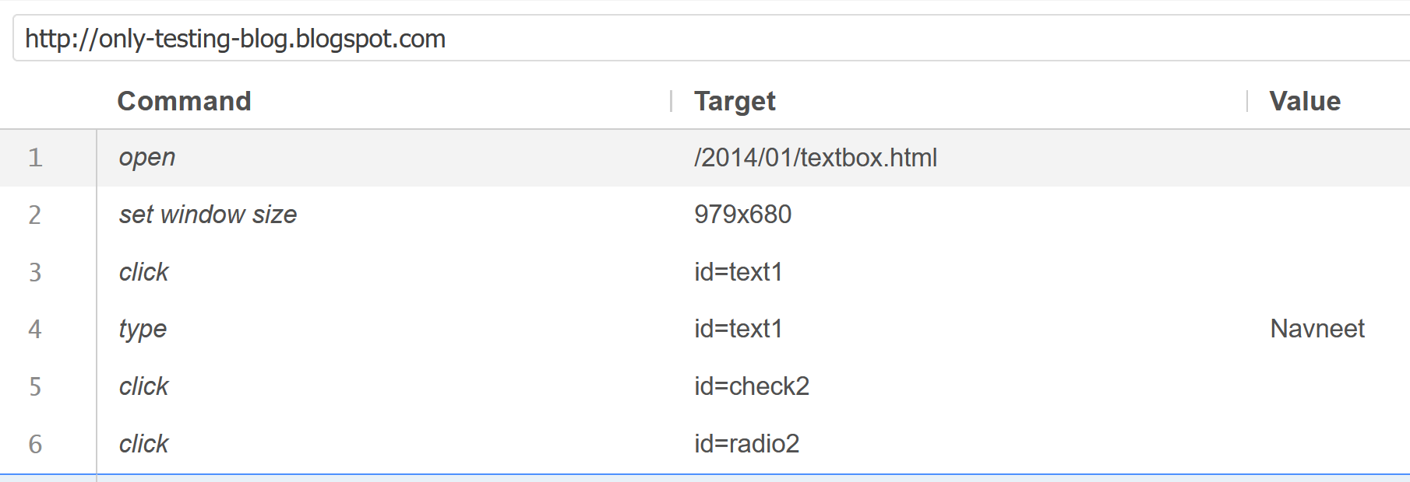
Start recording

Slide 15
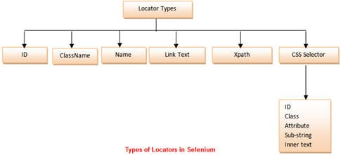
Locators
Ref: https://www.softwaretestinghelp.com/wp-content/qa/uploads/2014/10/Types-of-Locators-in-Selenium-1.jpg

Slide 16
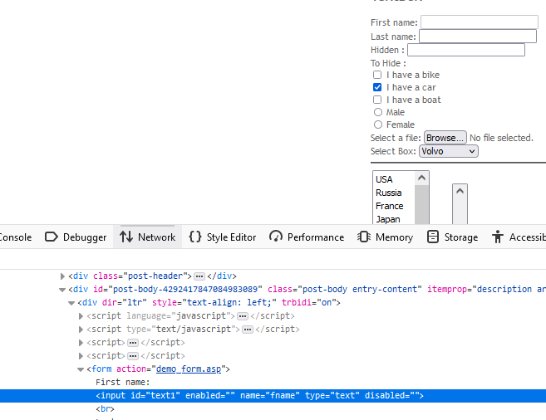
Locators in a web page
Two languages: HTML and CSS
HTML-Tag name, attribute, value

Slide 17
What is a CSS Selector?
Essentially, the CSS Selector combines an element selector and a selector value that can identify particular elements on a web page.
Like XPath, CSS selector can be used to locate web elements without ID, class, or Name.

Slide 18
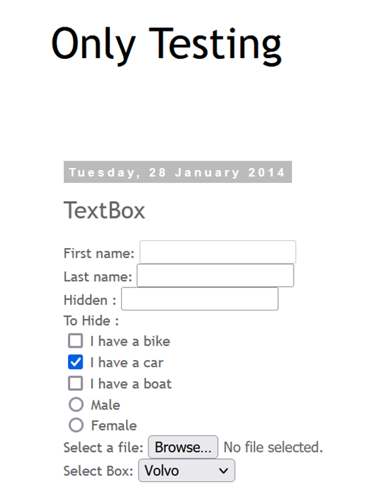
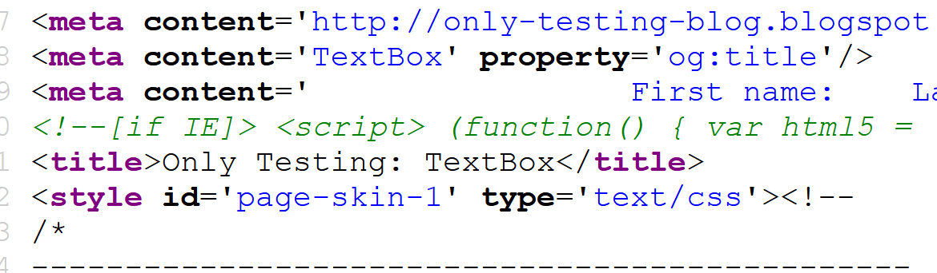
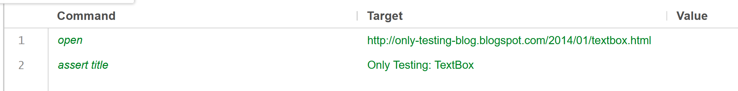
assert title command
Check whether the expected title is displayed
Green color indicates test has passed

Slide 19

Assert text and Verify text
assert text

Slide 20
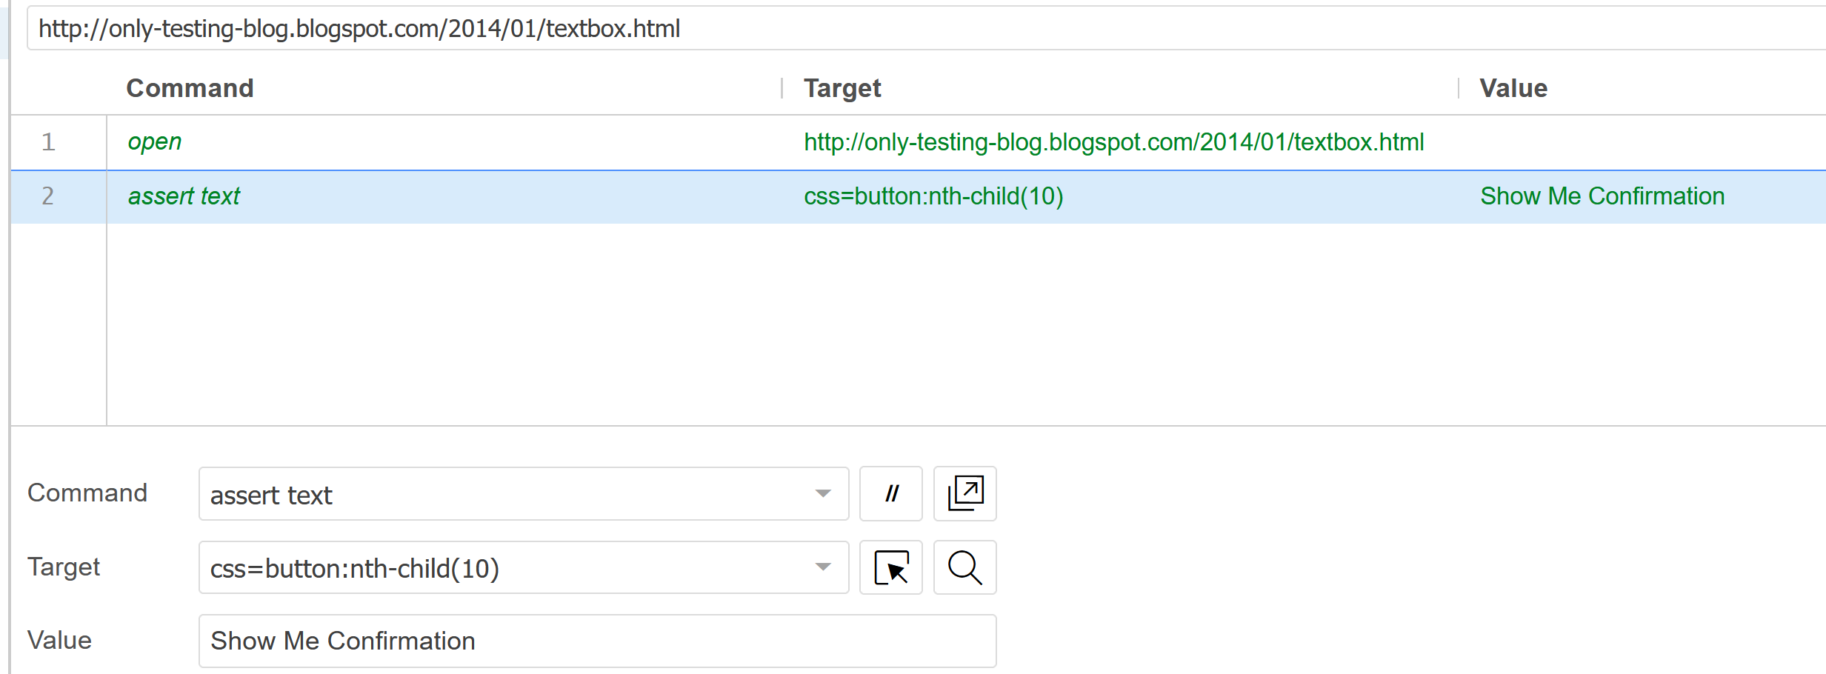



Test Passes
css=button may also work here.

Slide 21
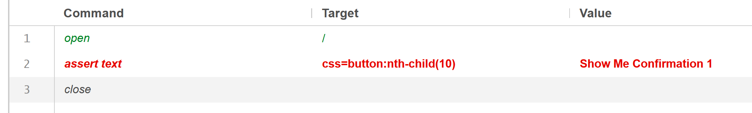
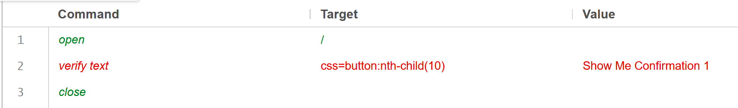
Assert vs verify

Slide 22
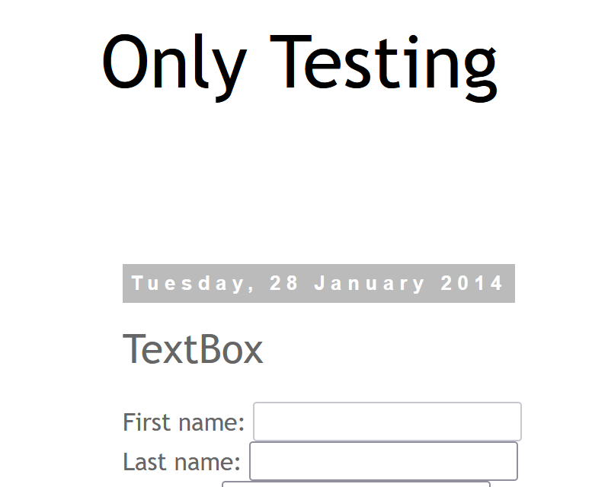
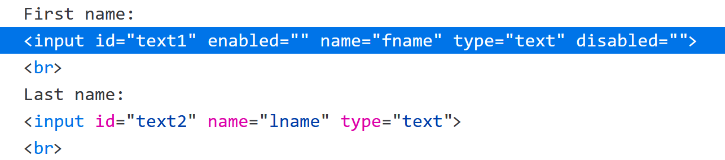
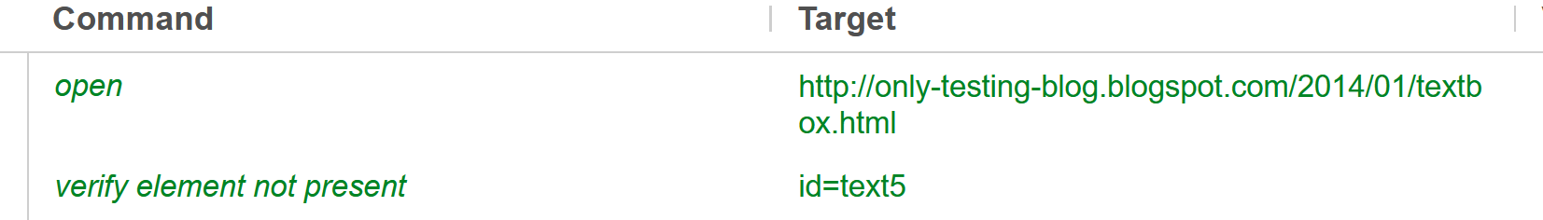
Verify element not present- http://only-testing-blog.blogspot.com/2014/01/textbox.html

Slide 23
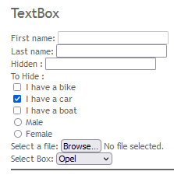
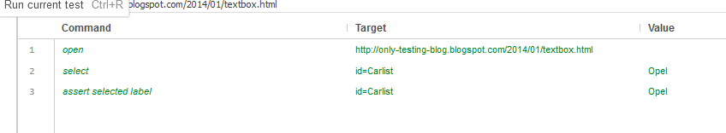
Assert selected label

Slide 24
Multiple selections
Go to website.
Select ‘Germany’ and ‘Japan’ from the selection list.
Verify that Germany was selected.

Slide 25
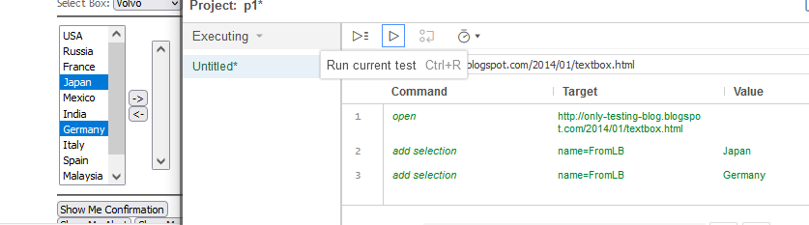
Select both Japan and Germany

Slide 26
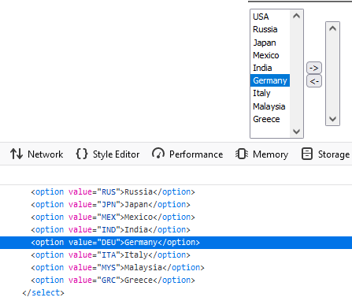
"assertSelectedLabel" Command
"assertSelectedLabel" command works with drop down or list box and useful to verify label (visible text) of selected label.
"assertSelectedValue" Command
"assertSelectedValue" command is also working with list box or drop down and useful to option value (value attribute) of selected label.

Slide 27
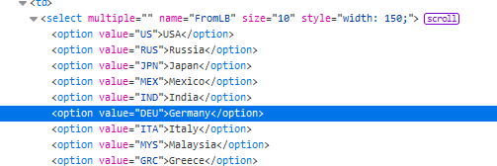
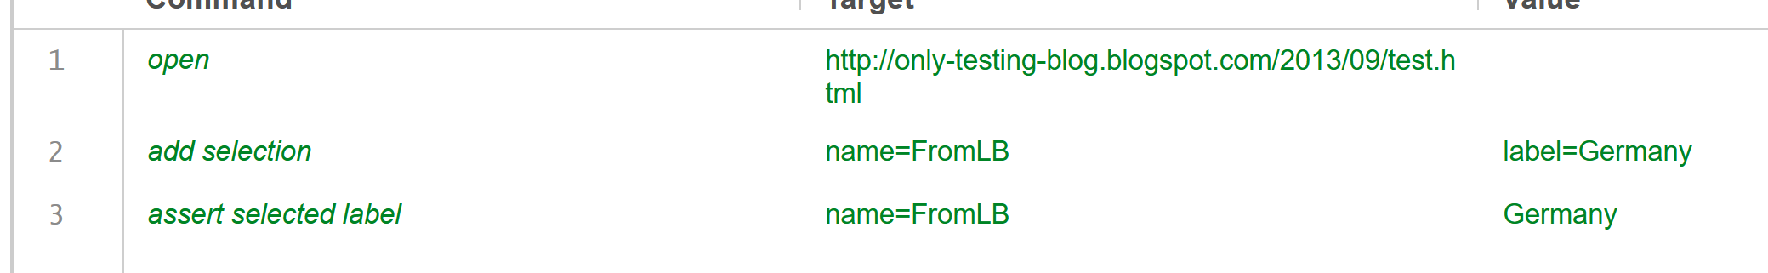
Above image shows HTML view of list box. As you see in image, selected option's visible text (Label)= 'Germany' which is marked with green line in HTML view and it's Value attribute = 'DEU’.
So if you want to use "assertSelectedLabel" command then you need to use 'Germany' in value column and if you want to use "assertSelectedValue" command then you need to use 'DEU' in value column. This is the difference between them.

Slide 28
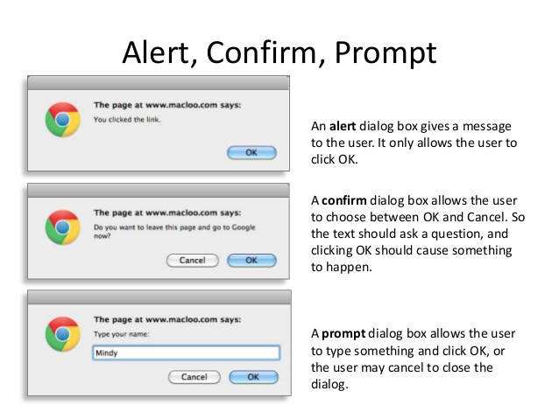
Ref: https://www.slideshare.net/macloo/javascript-101-16754994

Slide 29
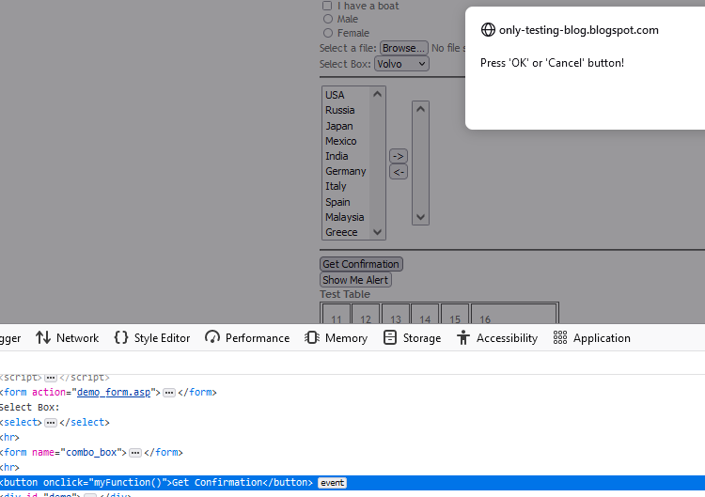
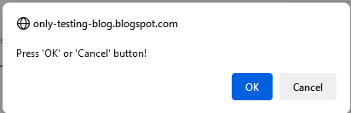
assert confirmation
“assert confirmation" command will retrieve the confirmation message text and compare it with targeted text.

Slide 30
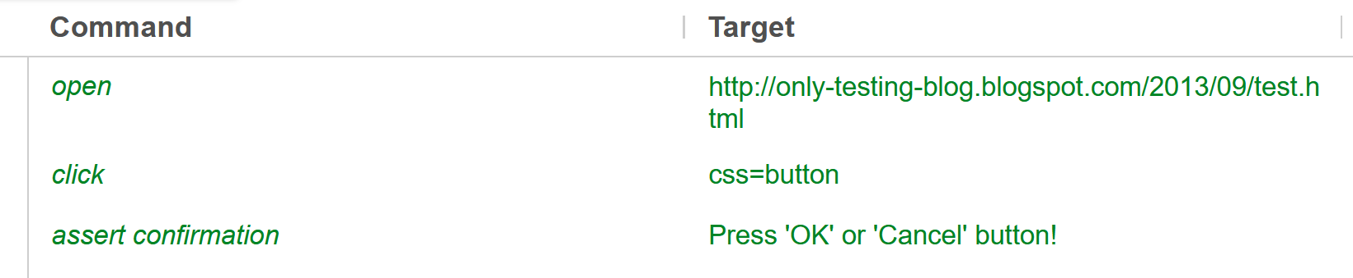



Slide 31
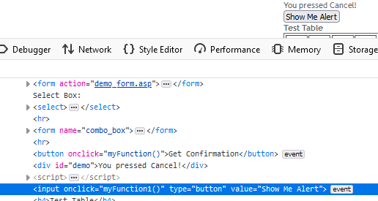
Assert alert

Slide 32
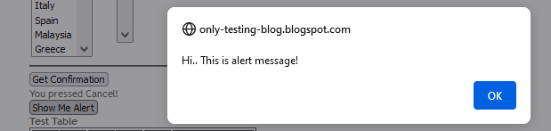
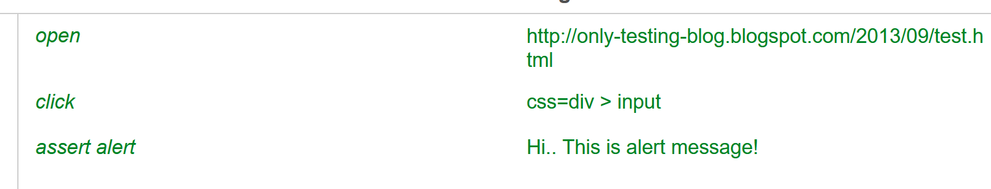

Slide 33
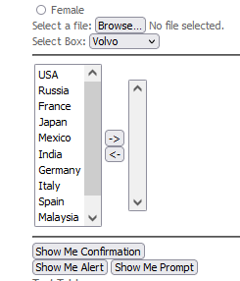
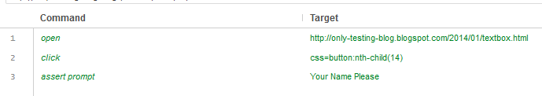
Assert prompt

Slide 34
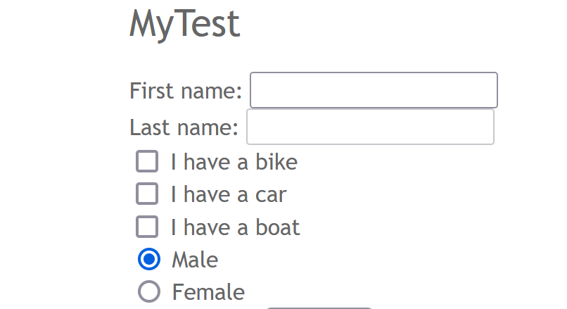
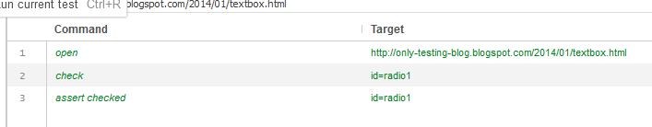
Assert checked- Verifying whether One of the Radio buttons checked or not checked

Slide 35
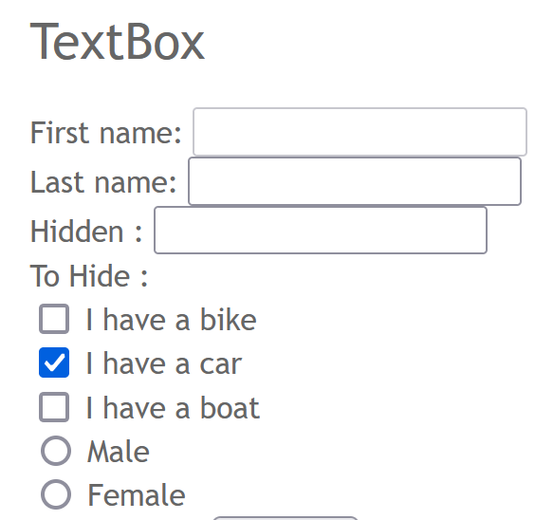
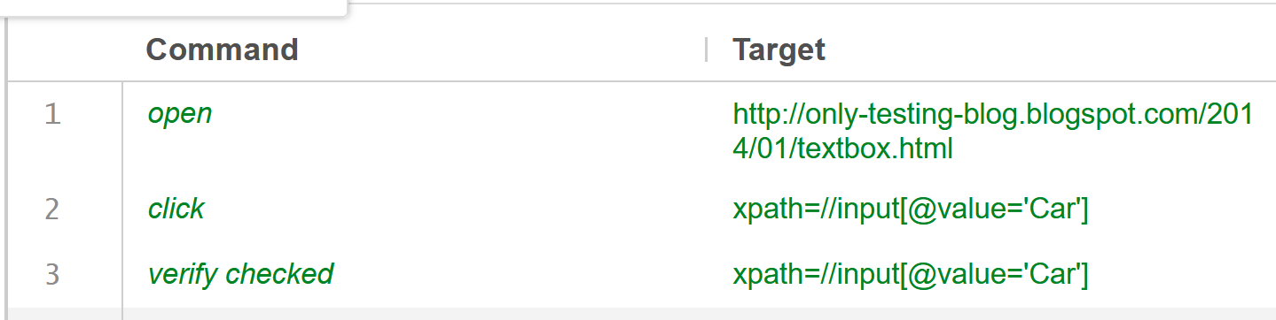
Verify checked- Verifying whether a particular check box is checked or not

Slide 36
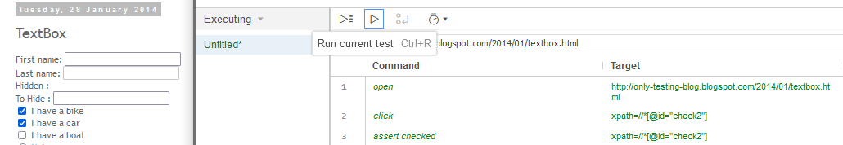
Bike will automatically be clicked because
‘Check’ is also going to work here
Id=‘check2’ is also going to work here

Slide 37
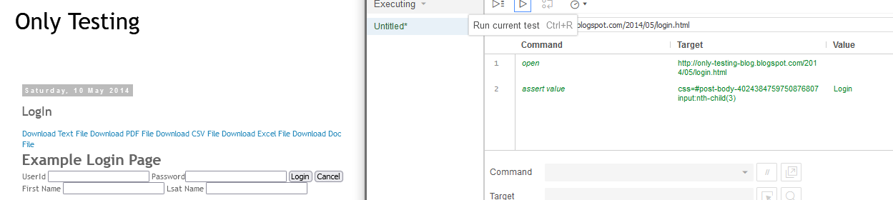
Assert value
http://only-testing-blog.blogspot.com/2014/05/login.html

Slide 38
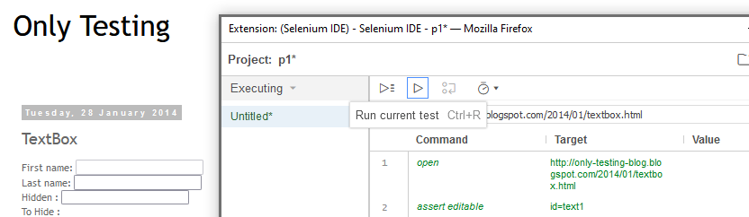
Assert editable

Slide 39
Ram your brains!!!!!
Assert/verify title- Only Testing: Selectable
http://only-testing-blog.blogspot.com/2014/09/selectable.html
Assert value-Cancel button
http://only-testing-blog.blogspot.com/2014/05/login.html
Assert text-’Double Click Me To See Alert’ button
http://only-testing-blog.blogspot.com/2014/09/selectable.html
Assert element present -fname, lname
Assert element not present -qname
http://only-testing-blog.blogspot.com/2014/06/alert_6.html
Assert whether a single check box is clicked or not https://www.seleniumeasy.com/test/basic-checkbox-demo.html
Assert editable- firstname textbox
http://only-testing-blog.blogspot.com/2014/06/alert_6.html
Radio buttons- select radio button ‘Female’ and assert whether it was selected or not
https://www.seleniumeasy.com/test/basic-radiobutton-demo.html
Assert text - click ‘bootstrap-duallist’ and assert its text
https://www.seleniumeasy.com/test/bootstrap-dual-list-box-demo.html
Select Friday from drop down list and assert it.
https://www.seleniumeasy.com/test/basic-select-dropdown-demo.html
Assert alert, confirmation and prompt.
https://www.seleniumeasy.com/test/javascript-alert-box-demo.html

Slide 40
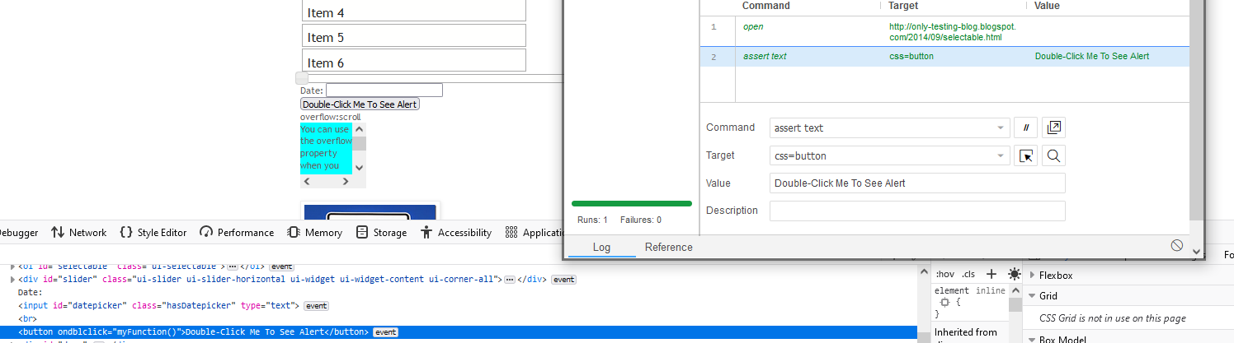
3. Assert text
http://only-testing-blog.blogspot.com/2014/09/selectable.html

Slide 41
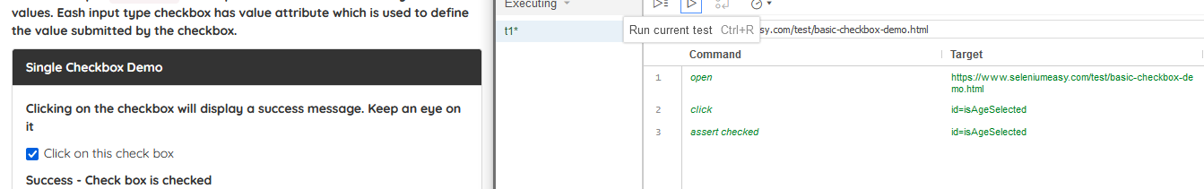
5. Assert checked

Slide 42
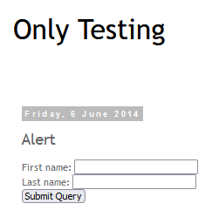
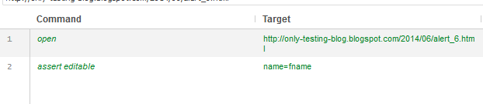
6. Assert editable

Slide 43
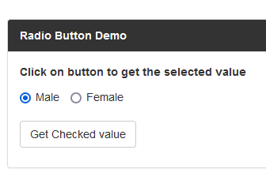
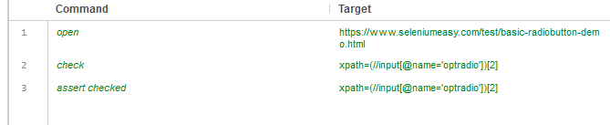
7. Radio button

Slide 44
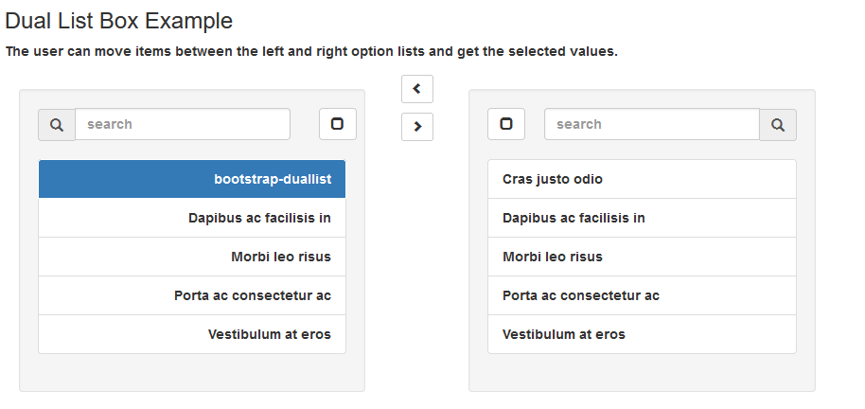
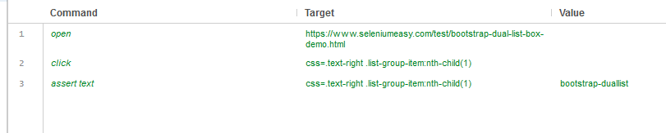
8. Assert text in a list

Slide 45
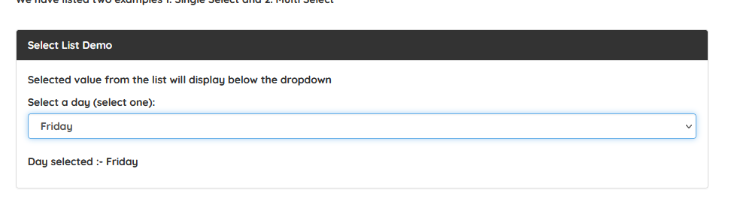
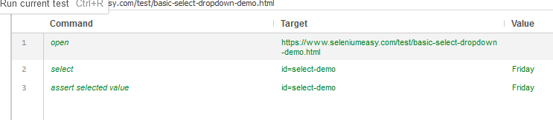
9. Assert selected value

Slide 46
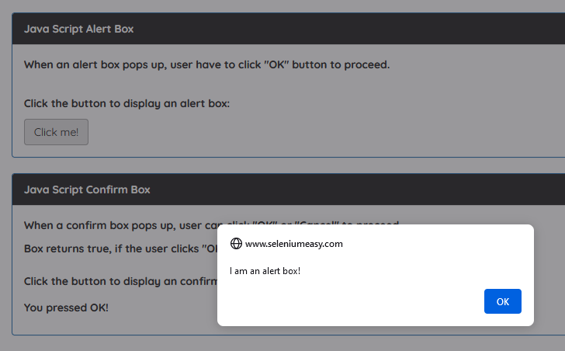
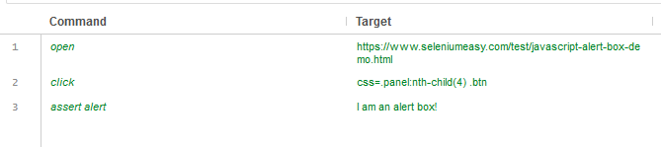
10. Assert alert

Slide 47
Other commands to check
Assert/verify not text:Confirm that the text of an element does not contain the provided value.
Assert/verify value:Confirm the (whitespace-trimmed) value of an input field (or anything else with a value parameter). For checkbox/radio elements, the value will be "on" or "off" depending on whether the element is checked or not.
Assert/verify selected value:Confirm that the value attribute of the selected option in a dropdown element contains the provided value.
Assert/verify not selected value:Confirm that the value attribute of the selected option in a dropdown element does not contain the provided value.
Assert/verify selected label:Confirm that the label of the selected option in a dropdown element contains the provided value.

Slide 48
Assert/verify checked: Confirm that the target element has been checked.
Assert/verify not checked:Confirms that the target element has not been checked.
Assert/verify editable:Confirm that the target element is editable.
Assert/verify not editable:Confirm that the target element is not editable.
Assert element present:Confirms that the target element is present somewhere on the page.
Assert element not present:Confirms that the target element is not present anywhere on the page.
Assert alert:Confirm that an alert has been rendered with the provided text.
Assert/verify confirmation:Confirms that a confirmation has been rendered.

